Slide 1
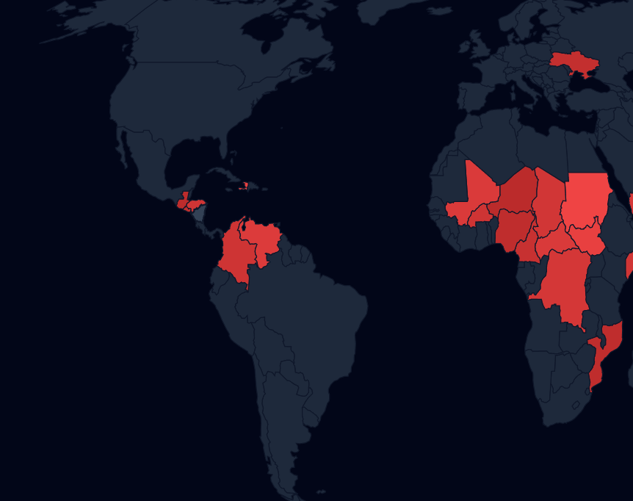
Geo-Insight: The Humanitarian Gap Analyzer
Empowering Human Judgment through Transparent Analytics

Slide 2
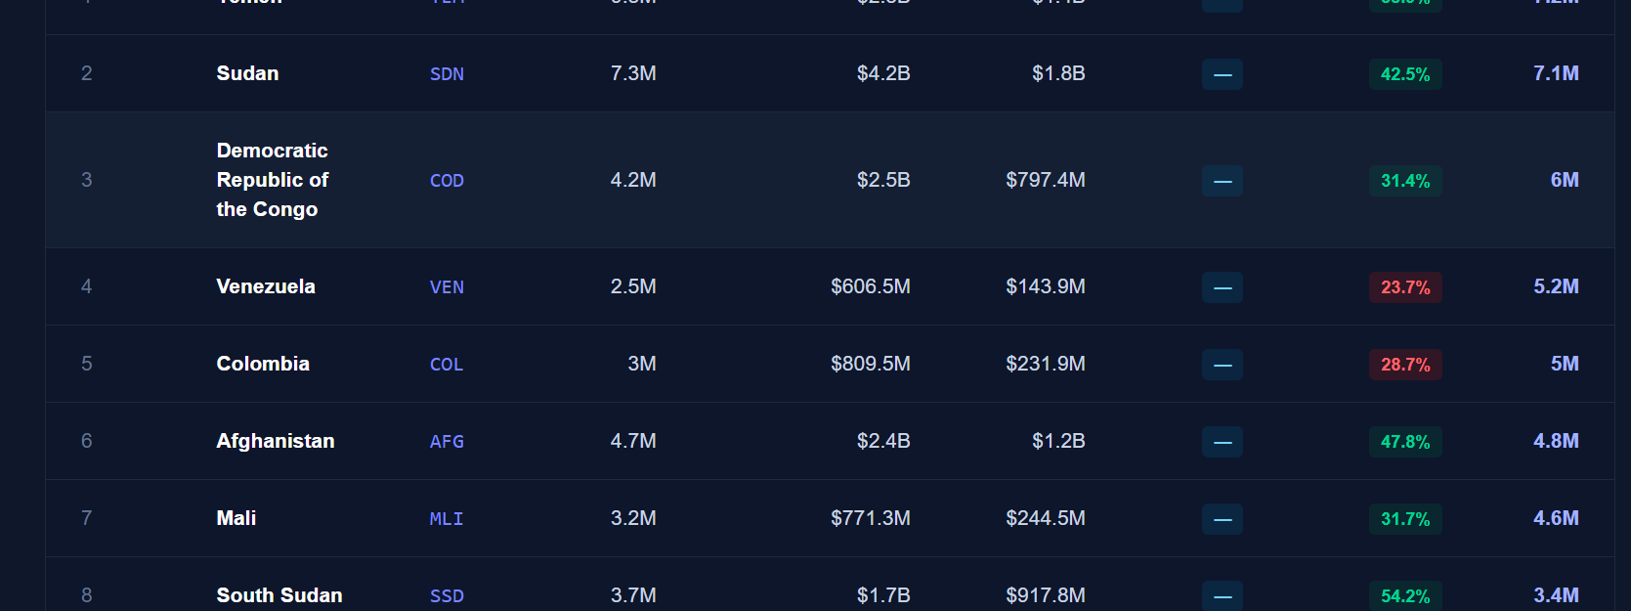
The Stakes
Human lives behind the data
Black-box AI risks
Public funding reputation

Slide 3
The Glass Box: Automate Understanding, not decisions
decidedly NO black-box decision models
Info Buttons reveal math, assumptions, and source
Speed up, dont replace

Slide 4

WMI & Smart Imputation
- 15 months of OCHA, FTS, and HNO data
Random Forest Imputation: Filling the missing data gaps
Weighted Mismatch Index
$$=0.3⋅\text{Severity}+0.3⋅\text{Need} \text{Density}+0.3⋅\text{Funding} \text{Gap}+0.1⋅\text{Complexity}$$

Slide 5
Real-World Impact & Prototype
Technical Stack:
Next.js 16
SVG Heatmaps
Vercel Serverless
Rich Tooltips

Slide 6
Conclusion
Transparency saves lives.
Our tool makes the UN act faster and smarter.

